Slide 1
Exploring Transfer Learning in Image Classification
Unlocking the Power of Pre-trained Models for CIFAR-10 Dataset

Slide 2
Table of Contents
Introductions to CIFAR-10 Dataset
Understanding Transfer Learning
Selection of VGG16 Model
VGG16 Architecture and Parameter Selection
Results Comparison: Transfer Learning vs. From Scratch
Limitations of Transfer Learning
Potential Areas of Improvement
Conclusion

Slide 3
Brief Overview
We delve into image classification, exploring the transfer learning through a case study on the CIFAR-10 dataset.
Our discussion will include an introduction to CIFAR-10, understanding of transfer learning, and the strategic selection of the VGG16 model.
We will unravel the architecture of VGG16, discuss parameter choices, and compare results between transfer learning and training from scratch.
We'll assess the limitations of transfer learning and identify potential areas of improvement.
Our aim in this presentation is to provide insights into the effectiveness of leveraging pre-trained models for image classification tasks.

Slide 4
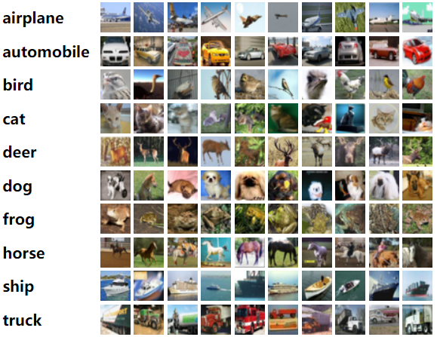
Introductions to CIFAR-10 Dataset
An established dataset comprising 60,000 32x32 color images across ten distinct classes (e.g., airplanes, automobiles, birds, cats, etc.).
Widely recognized as a standard benchmark dataset in the field of computer vision and machine learning.
Primarily used for evaluating and comparing the performance of various image classification algorithms.

Slide 5
Understanding Transfer Learning
A machine learning approach where knowledge gained from solving one problem is applied to a related but different problem.
Notably accelerates the learning process by leveraging existing knowledge from pre-trained models, leading to improved performance.
Reduces the need for extensive data, computational resources, and training time while achieving superior results.
Selection of VGG16 Model:
Deep convolutional neural network architecture.
Originally trained on ImageNet dataset for large-scale image recognition.
Architecture suits the complexity of CIFAR-10's image classification task.
Effective feature extraction capabilities.

Slide 6
VGG16 Architecture and Parameter Selection
Transfer Learning (With VGG16):
A convolutional neural network that is trained on ImageNet. Multiple convolutional and pooling layers make up the architecture, offering a robust feature extraction framework. To adapt the network to the CIFAR-10 dataset, custom layers are added, including Flatten, Dense (256 units, ReLU activation), Dropout (50% dropout), and an Output Layer (10 units, Softmax activation). We have used a batch size of 128 and trained the model on 10 epochs using the Adam optimizer with a learning rate of 0.0001. The loss function used categorical cross-entropy.

Slide 7
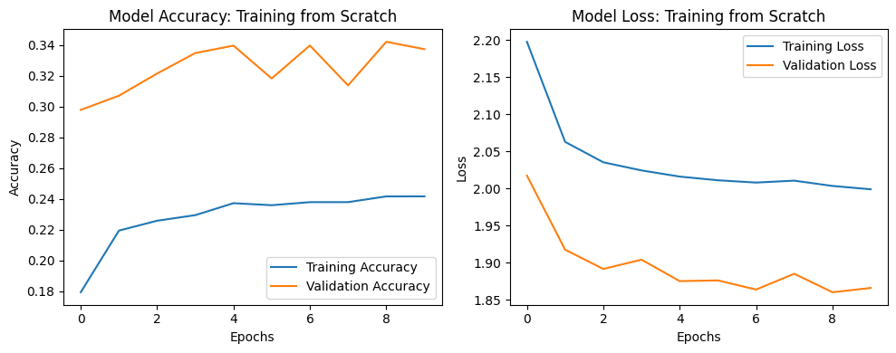
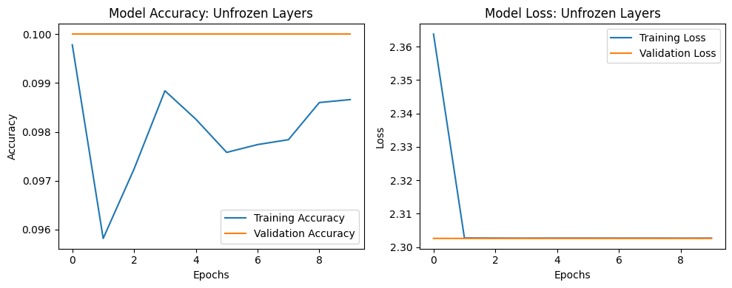
Results Comparison: Transfer Learning vs. From Scratch
Graphs showcasing Training and Validation Accuracy/Loss trends over epochs for Transfer Learning and Training from Scratch models.
The graph shows that TFS model achieve high accuracy on 8 epoch which 34% on validation data and on training data it achieved 24% accuracy.
If we look at the TL (Unfrozen layers) graph on it is clear that TL achieves notably higher accuracy and lower loss values for validation data.

Slide 8
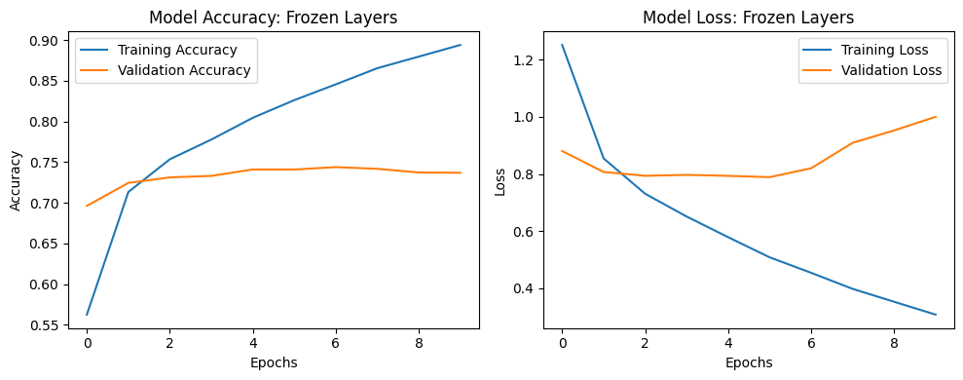
Results Comparison: Transfer Learning vs. From Scratch (cont)
TL (FL) model VGG16 have achieved higher accuracy on training data which is closed 90% and on validation data it has achieved above 70%.
Based on the results it is clear that VGG16 (unfrozen) model work best for our problem then the TFS.

Slide 9
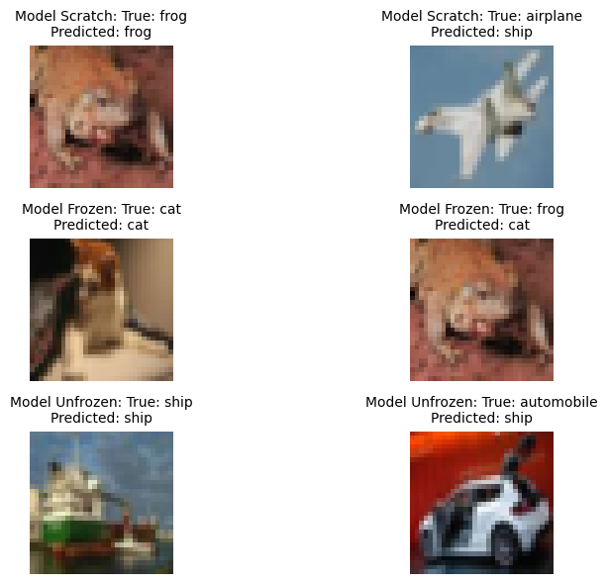
Visualize of correctly and incorrectly classification from the models
The visualizations provide insights into the strengths and weaknesses of each model. Examining correct predictions helps understand where the models perform well, while analyzing incorrect predictions can reveal specific challenges or areas for improvement.

Slide 10
Limitations of Transfer Learning
Differences between the original pre-trained domain (e.g., ImageNet) and the target CIFAR-10 domain might affect performance.
Possibility of transferring irrelevant features or biases from pre-trained models, impacting performance.
Limitations in adaptability to new tasks without suitable fine-tuning or adjustments, as indicated by the disparity in test accuracy and loss.
Potential Areas of Improvement:
Focus on advanced methods to align pre-trained models more effectively with target domains like CIFAR-10.
Devise precise fine-tuning strategies to reduce biases and further optimize model performance.
Focus on architectures to design an improved model that reduces the test accuracy difference between Transfer Learning and Training from Scratch by allowing higher transferability between tasks and datasets.

Slide 11
Conclusion
From the results, it is clear that Transfer Learning (TL) performs better than Training from Scratch (TFS) in regard to accuracy and loss metrics.
TL outperforms TFS on test and validation datasets, showing faster convergence and higher accuracy.
To fully realize the potential of TL in solving practical issues, it is necessary to explore its wide range of applications.
TL offers us the chance to greatly enhance the way we approach difficult problems in a variety of fields.
References:
https://medium.com/@mygreatlearning/everything-you-need-to-know-about-vgg16-7315defb5918
https://www.mathworks.com/help/deeplearning/ref/vgg16.html
https://www.geeksforgeeks.org/vgg-16-cnn-model/
https://towardsdatascience.com/fine-tuning-pre-trained-model-vgg-16-1277268c537f
https://www.cs.toronto.edu/~kriz/cifar.html
https://www.tensorflow.org/datasets/catalog/cifar10

